Slide 1
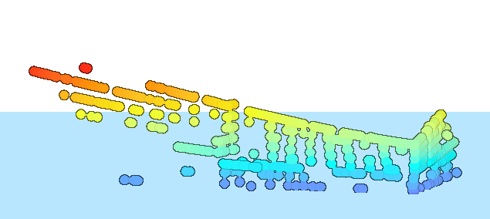
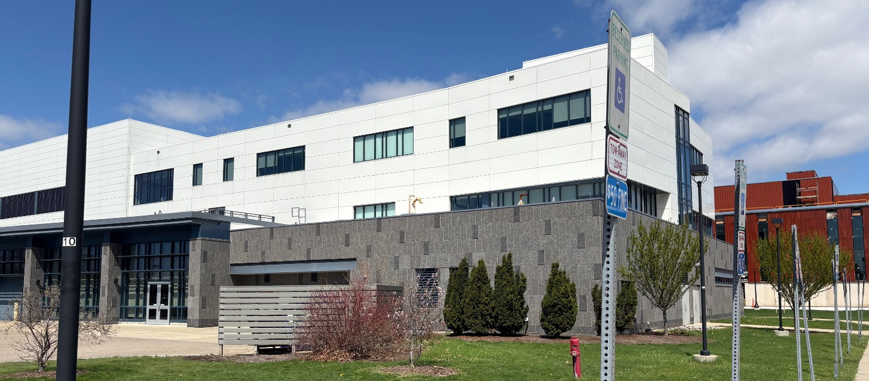
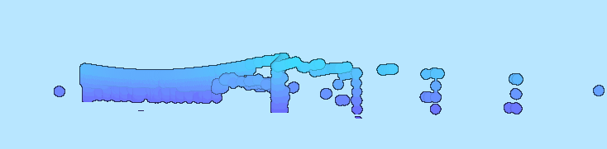
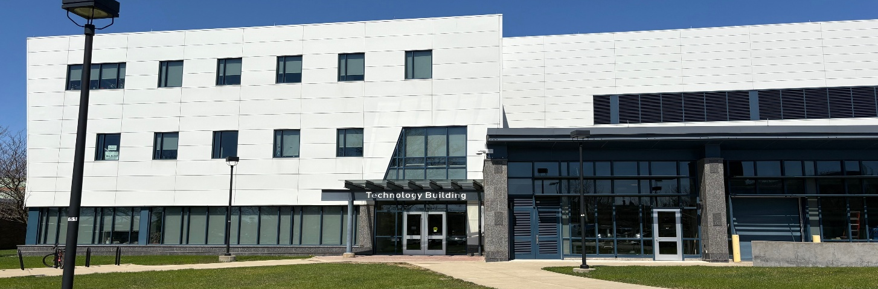
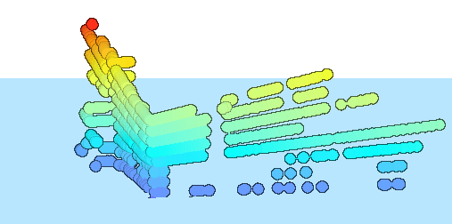
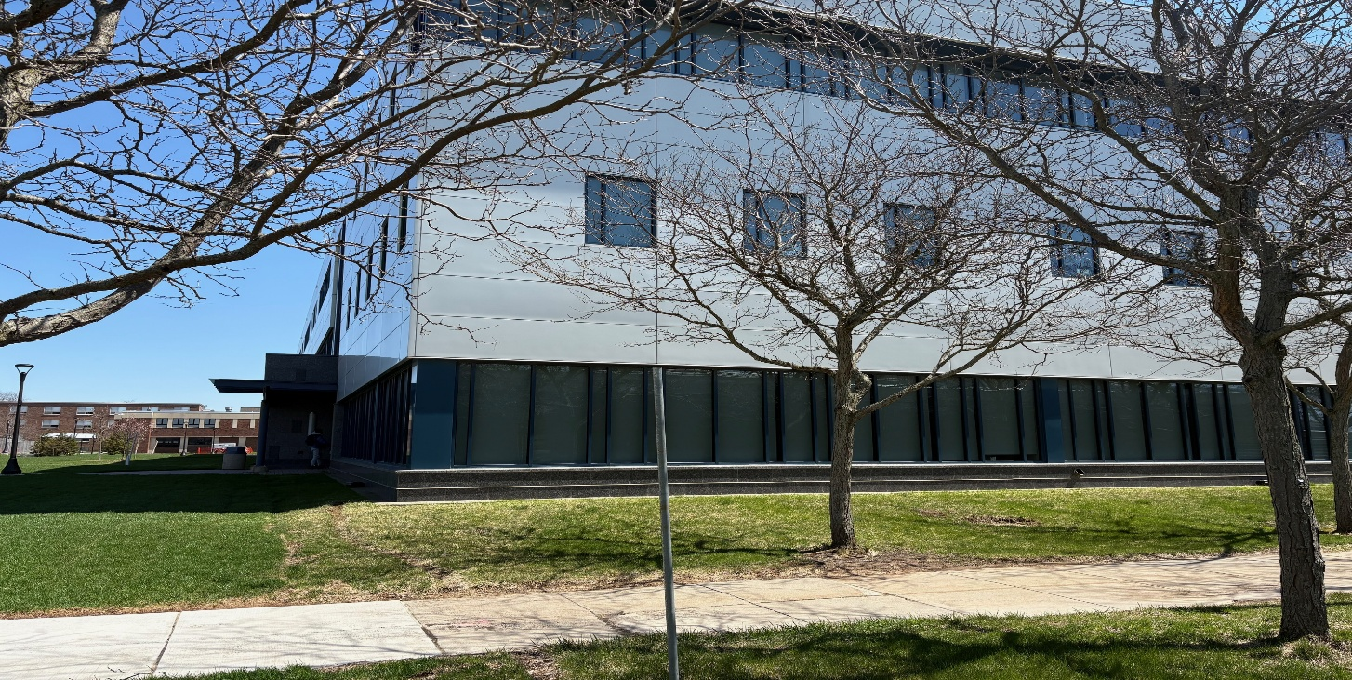
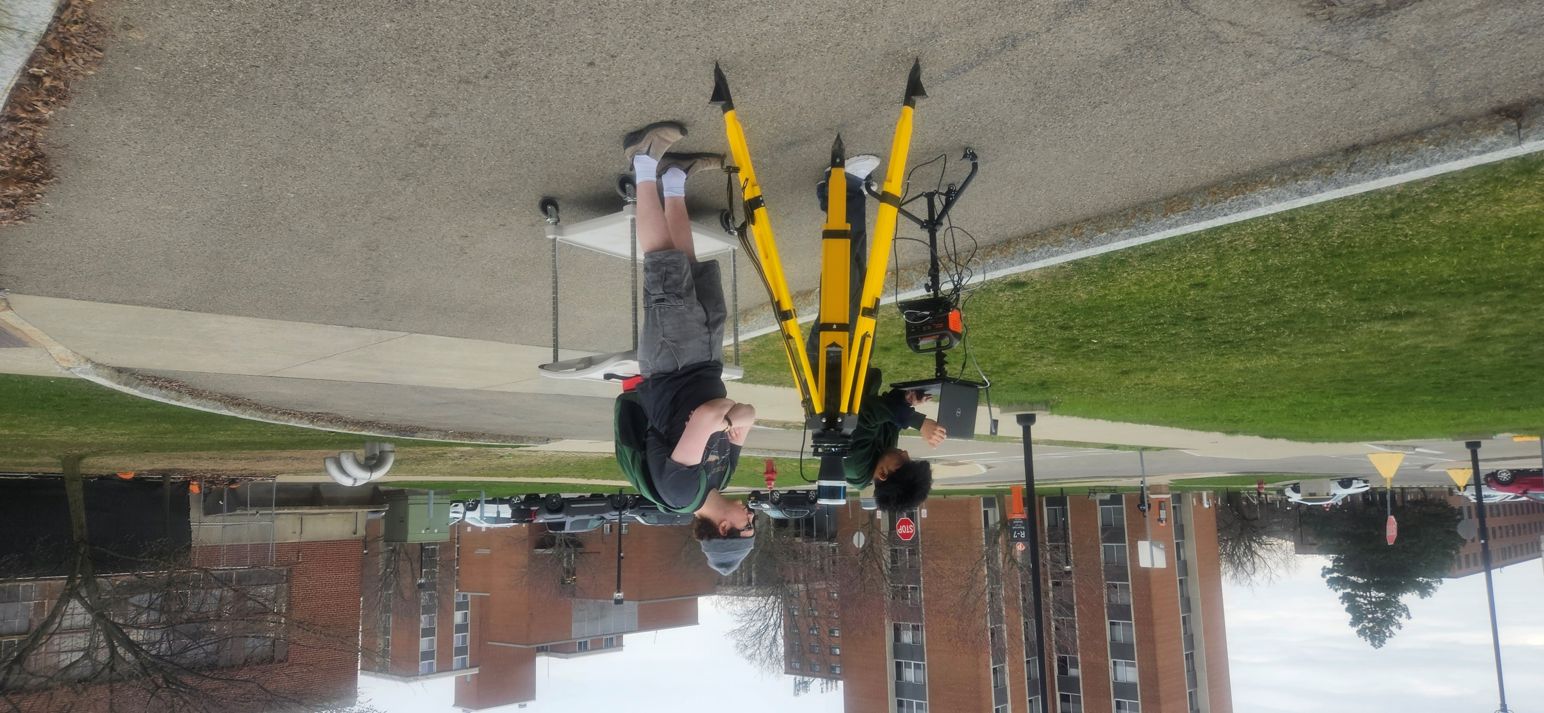
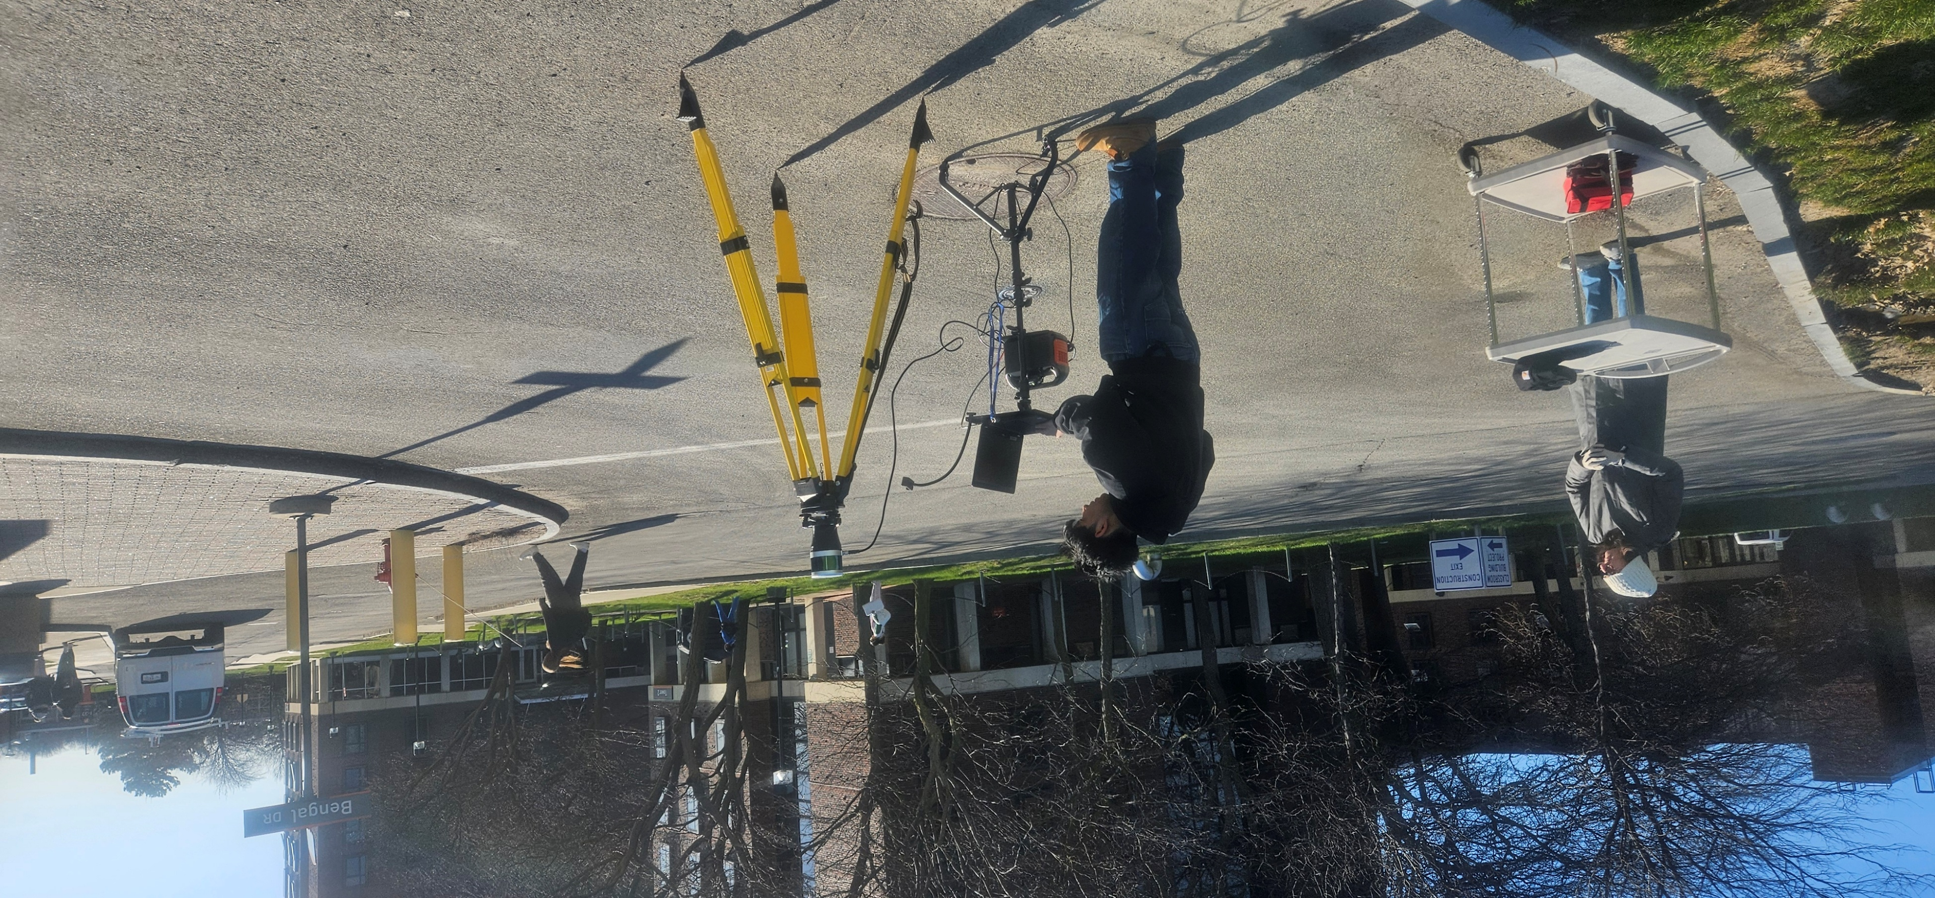


Creating a Portable LiDAR 3D Data Collection System for Computational Virtual Reality Environment Building
Presenter: Abdullah Abadi · Computer Information Systems · Mentor: Dr. Tao Tang, Mary F. Perrelli, Geosciences
Abstract
Results
Interpretations of Findings
To build virtual reality models in a computational environment, it is essential to collect accurate three-dimensional (3D) data from real-world structures. This project focuses on assembling a portable LiDAR (Light Detection and Ranging) system to capture and visualize 3D point cloud data for mapping buildings and structures. The primary goal is to design and integrate key components, including a LiDAR scan head, GPS unit, laptop computer, and portable power supply, into a cohesive system capable of collecting high-resolution 3D spatial data. After assembling and testing the system, we conducted field surveys at the Technology Building and Science and Mathematics Complex (SAMC) to acquire detailed 3D datasets, including color images of building walls and roofs. The collected data was processed and visualized to support the creation of virtual reality models with measurable scale in a computational environment. This system will enable the collection of geographically accurate 3D datasets for various campus buildings.
The LiDAR scans successfully captured portions of the Technology Building, recording some structural details and dimensions. However, the overall accuracy of the scans was limited. The system was unable to capture the entire building or even one complete side, resulting in partial data coverage. Consequently, only segments of the building were represented in the final point cloud model.
Front and Side View (ArcGIS Pro)
Front and Side View (Technology Building)
Conclusions
Front View (ArcGIS Pro)
Front View (Technology Building)
While the system captured useful portions of the Technology Building, it faced limitations in scan coverage and completeness. These results highlight both the promise and challenges of portable LiDAR for creating accurate virtual models. Future improvements in system configuration, scanning strategy, and data processing could enhance coverage and precision, making this approach more viable for comprehensive digital reconstruction of campus structures.
Inspiration and Background
Back and Side View (ArcGIS Pro)
Back and Side View (Technology Building)
The growing demand for immersive and data-rich virtual environments has driven the need for accurate 3D spatial data. Traditional methods of 3D modeling often rely on manual measurements or static systems, which can be time-consuming and limited in detail. Inspired by the potential of LiDAR technology to revolutionize spatial data collection, this project set out to create a portable and efficient system for capturing high-resolution 3D point cloud data.
References
Jensen, J. R. (2003). Remote Sensing of the Environment – An Earth Resource Perspective. Second Edition, Prentice Hall, Inc., Upper Saddle River, NJ 07458, 592p.
Instruction Manual: https://www.manualslib.com/manual/2068017/Leishen-Intelligent-System-C16-Series.html#manual
Video Instruction: https://www.youtube.com/watch?v=HEOoEo393ks
Portable LiDAR
Methodology
LiDAR System Assembly:
Built a fully portable LiDAR system by integrating a LiDAR scan head from LSLIDAR (Shanghai, China), a GPS unit, a laptop computer, and a portable power supply. This setup allowed for mobility and real-time data acquisition in outdoor and indoor environments.
Device Configuration:
The LiDAR scanner was configured by installing and optimizing necessary drivers and software to ensure seamless communication with the laptop. This setup allowed the scanner to operate reliably and capture accurate data during fieldwork.
Data Acquisition:
Conducted field surveys of the Technology Building. The scanner captured dense point clouds through systematic passes, representing building walls, and surrounding features.
Data Processing:
The collected point cloud data was processed using the Upper Computer platform, which translated the LAS laser data into structured 3D spatial information.
3D Modeling and Visualization:
Final modeling was performed using ArcGIS Pro. The point cloud data was classified and filtered to isolate building structures. Unnecessary data points were removed to enhance clarity, leaving only the relevant features for visualization.
Acknowledgements
This project is partially funded by Office of Undergraduate Research at Buffalo State University and SUNY LSAMP grant from National Science Foundation.
Dr. Sarbani Banerjee, for her assistance in securing the grant and funding that made this project and its necessary equipment possible. Mr. Jonathan R Rosten and Dr. James Mayrose from the Engineering Technology Department, for their help in building the equipment..

